Slide 1
CAAT
AnisoMPM: Animating Anisotropic Damage Mechanics

Slide 2
Meet the team
Chase Austin - Team leader?
Addison Dugal - Algorithm adapting
Alex Finch - User interface/Blender Add-on Design
Thomas Wise - Backend Programmer

Slide 3
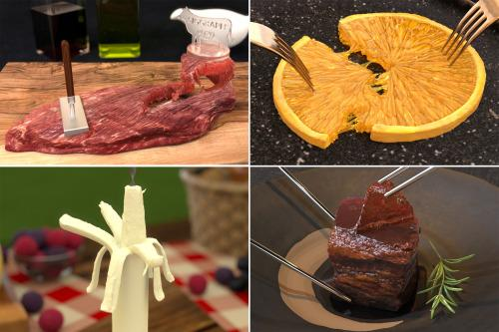
Paper on AnisoMPM
Joshuah Wolper, Penn grad student: AnisoMPM, Animating Anisotropic Damage Mechanics
A method for calculating and animating damage to anisotropic (having different properties in different directions) objects such as meat
Creates a much more accurate and dynamic animation

Slide 4
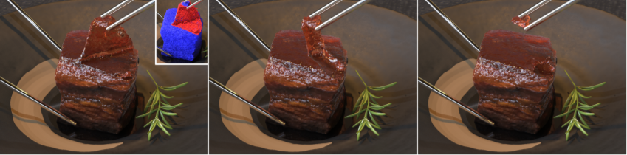
AnisoMPM
Algorithms are flexible and can represent different types of damage and materials
Demonstrated here on Dongpo pork:
Orthotropic damage and orthotropic elasticity
Just isotropic damage
Transverse isotropic fibers

Slide 5
Short term Goals
Learn to use and work with Blender, gaining a familiarity with the software and the process of creating add-ons and assets
Start implementing the algorithms in code
Determine method of content delivery of algorithms - choosing if this will be an add-on, a type of asset such as an animation procedure, or something else entirely

Slide 6
middle goals
To have a functioning animation that allows a block of a material to be torn using the algorithms discussed in the AnisoMPM paper but having that animation be constructed in blender.
The user interface only needs to accompany us and not necessarily the end user at this point.

Slide 7
Long term Goals
Fully develop the add-on so that the end users can run simulations as simply and easily as possible.
Allow the users to design a 3D model, specify what movement is being made (where it’s being pulled on, cut into, etc.) and run the simulation without leaving Blender.
Allow the users to also add more details if they desire. It should be easy to use, but they should also be able to specify what parts of the model are what material, what they want to save from the simulation (video animation, frame by frame models, or just the end result), and other features that may be useful.

Slide 8
Joshua wolper
Main Author of the paper AnisoMPM: Animating Anisotropic Damage Mechanics
pursuing PhD in Computer and Information Science, at University of Pennsylvania
His suggestion was to use a software Houdini, however we decided as a team to stick with blender since we have already been working on blender.
Because blender does not have features that make visualization of MPM as easy as Houdini

Slide 9
Joshuah’s code
The demos of his code can only be operated or run on a Linux or a GNU system. this however does not mean that the actual code and algorithms do not work outside of a Linux or a GNU system.
The github here: https://github.com/penn-graphics-research/ziran2020.

Slide 10
Issues/Concerns
The original paper was implemented using a GNU operating system, meaning certain types of testing and research into the original solution will be challenging to implement on our workstations.
The authors recommend an implementation in SideFX: Houdini. This software is expensive, licensed, and considerably locked down compared to the free and open Blender software. However, if the original implementation is designed with Houdini in mind, there may be issues translating it over.
Our long-terms goals are somewhat lofty, and while theoretically doable, may prove challenging working part-time over the better part of 2 semesters. Some ideas may need scaling back.

Slide 11
Citations:
Joshuah Wolper, Yunuo Chen, Minchen Li, Yu Fang, Ziyin Qu, Jiecong Lu, Meggie Cheng, and Chenfanfu Jiang. 2020. AnisoMPM: Animating
University of Pennsylvania

